Slide 1
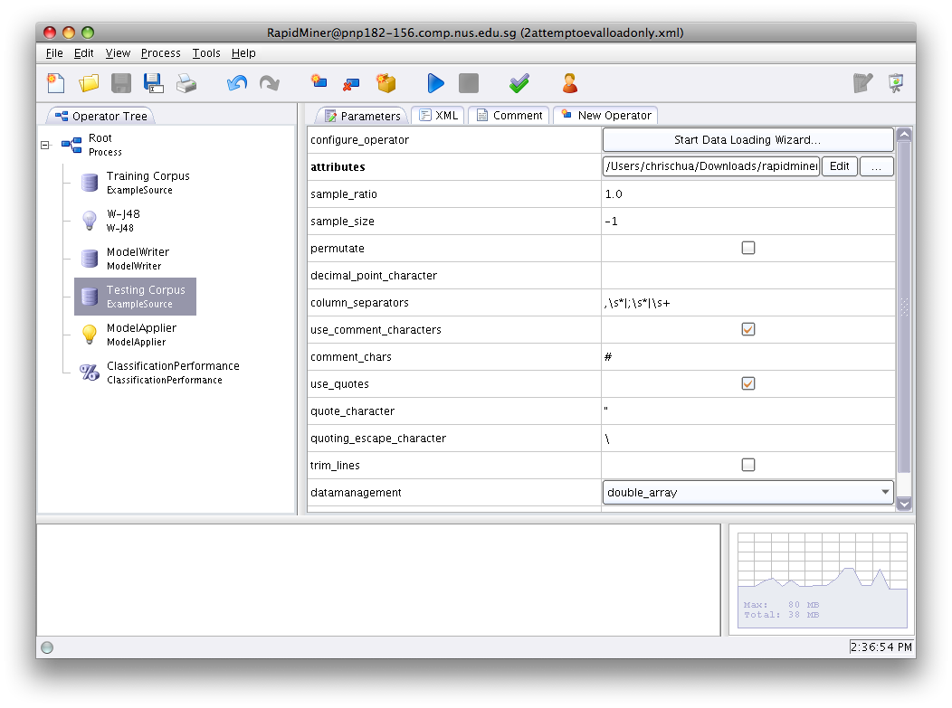
Text Categorization
By
Low Choon Meng (U053736R)
Chua Kien Chuan (U087140B)
Xu Wei Jie (U057020R)

Slide 2
Project Tasks
Implementation of KNN and Decision tree classification
Perform of live classification using the GUIs

Slide 3
Algorithm Gist
KNN
Terms are selected based on their document threshold and the category threshold
Terms that do not help in classification are appended to stoplist
Training and test sets are stemmed using the new stoplist
Calculate similarity metrics of a given document against the training set
These metrics are sorted and K largest are picked
Max of the summation of similarity metrics for each category
determines the classification
Decision Tree
Trees are constructed using RapidMiner
Tree pruning attributes are placed into the RapidMiner software to enhance the
structure of the tree
The model generated is used for tree traversal in Java platform
The tree is accessed for the categorization for the test documents with the help
of API calls provided by RapidMiner/Weka

Slide 4
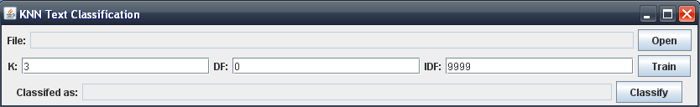
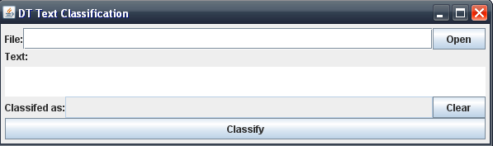
GUI

Slide 5
Test Results
KNN Testing
We ran K values of 1-20 and our highest accuracy is 60% at k=16
By enhancing the TermSelection, we obtain 62% accuracy
Decision tree Testing
By building several trees for testing, we obtain the best accuracy using
W-j48 tree which yields 88% accuracy

Slide 6
Questions and Answers

